Slide 1

PRPLOS Authentication & API Strategy
Understanding REST, JSON-RPC, and WebUI Integration
Presented by: Karthikeyan Manickavel
Date: August 14, 2025 | Version: 1.0

Slide 2
What We'll Cover Today
01
02
03
Authentication Fundamentals
REST API Overview
JSON-RPC Deep Dive
A simple explanation of how systems verify identity.
The external communication language for web applications.
The internal language for system-to-system calls.
04
05
PRPLOS Endpoint Strategy
Complete System Flow
Specifics on /session, /commands, and /rpc.
Tracing the journey from REST to JSON-RPC to Data Manager.

Slide 3
Architectural Overview: PRPLOS Communication Flow
This diagram illustrates the comprehensive flow of requests within the PRPLOS ecosystem, from the user's web browser down to the Data Manager. Understanding this flow is crucial for debugging and optimizing our system's performance and security.

Slide 4
REST API vs. JSON-RPC: Two Communication Paradigms
Aspect
REST API
JSON-RPC
Purpose
External web communication (e.g., public APIs)
Internal system communication (e.g., microservices)
Style
Resource-based, using standard HTTP methods (GET, POST, PUT, DELETE)
Method-based, invoking specific functions/procedures
URL Example
/api/v1/users/123
/session or /commands
Action Style
HTTP Method dictates action on resource
Method name explicitly stated in message body
Analogy
Like a filing cabinet with folders and documents
Direct function calls to specific services
Best For
Web browsers, mobile apps, public integrations
System-to-system calls, inter-process communication
PRPLOS Usage
Web UI communication
Internal processing, data management
In PRPLOS, we leverage both systems in concert to provide a robust and efficient communication architecture.

Slide 5

PRPLOS Endpoint Strategy: Specialized Communication
Our architecture smartly divides responsibilities to optimize flow and security.

Slide 6
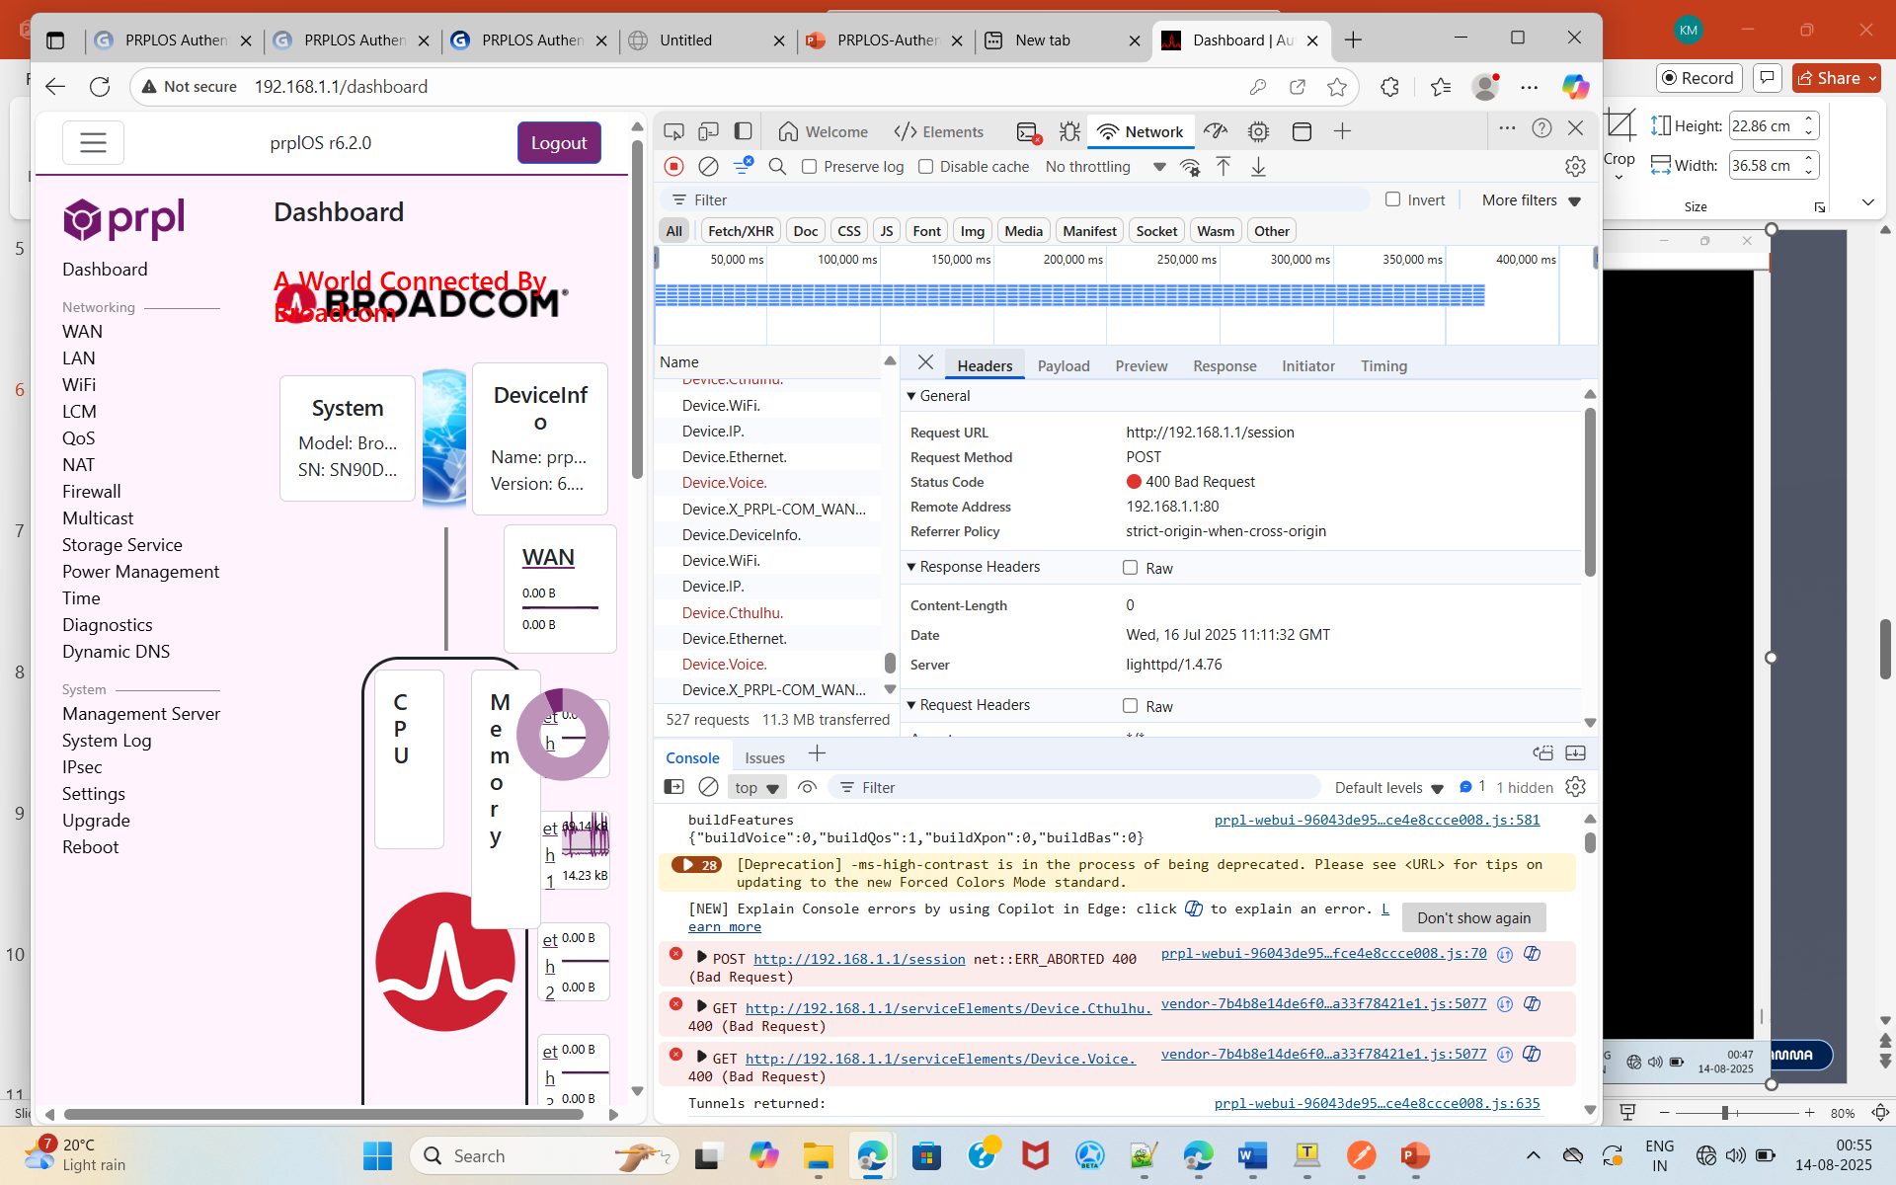

Slide 7
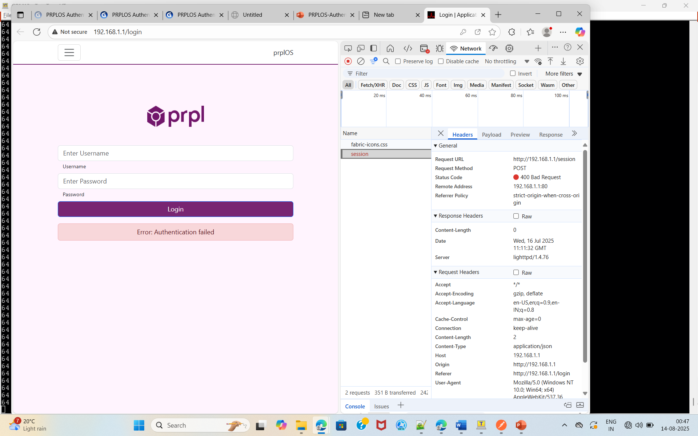

Slide 8

PRPLOS REST API Endpoints: The Public Interface
These endpoints handle external interactions, primarily from the Web UI, ensuring secure and standardized access to system functionalities.
{https/http}://[device-ip]/api/v1/auth/login: Handles user authentication and session creation. Expects credentials and returns a session token.
{https/http}://[device-ip]/api/v1/auth/logout: Terminates an active user session, invalidating the session token.
{https/http}://[device-ip]/api/v1/user/profile: Retrieves detailed profile information for the authenticated user.
{https/http}://[device-ip]/api/v1/system/status: Provides real-time health and operational status of the PRPLOS system.
These REST endpoints are designed for broad interoperability, allowing various client applications to securely interact with the PRPLOS device. They follow standard HTTP conventions for ease of integration.

Slide 9



PRPLOS JSON-RPC Endpoints: The Internal Workhorses
These endpoints serve as the direct interface for internal system operations, leveraging JSON-RPC for efficient, method-based communication within the PRPLOS backend.
/session
/commands
/rpc
Dedicated for core authentication and user session management, including token validation and session state changes. Chosen for its direct mapping to user session lifecycle.
Executes specific system commands and administrative actions. Its explicit naming clarifies its role in controlling device behavior. Think of it as direct access to system utilities.
A generic endpoint for diverse data operations and less frequently used methods. This endpoint acts as a catch-all, centralizing various RPC calls into a single, manageable interface.
This tripartite division ensures clear responsibility and simplifies internal routing logic.

Slide 10



Why Specific JSON-RPC Endpoints?
/session: Customer Service Desk
/commands: Technical Support Desk
/rpc: General Information Desk
Handles all user-facing authentication and session state changes. It's the primary point of contact for user identity.
Processes direct system commands and actions. This is where the backend executes specific tasks or configurations.
Manages a broader range of RPC calls for data retrieval, updates, and other general operations that don't fit into the other specific categories.
This segmentation provides clarity, enhances maintainability, and aligns with the principle of least privilege by grouping related functionalities.

Slide 11

Authentication Flow: A Detailed Look
Enter Credentials
Authentication Server
Authorization Granted
Session Created
The diagram above illustrates the step-by-step process of user authentication within PRPLOS, from initial credential submission to secure session establishment and subsequent authorized interactions with the system.

Slide 12
Key Takeaways & Next Steps
Key Takeaways:
Next Steps:
PRPLOS uses a hybrid API strategy for optimal performance and security.
Review detailed API documentation for implementation guidelines.
REST APIs are for external, user-facing communication (Web UI).
Conduct integration testing on all identified endpoints.
Discuss potential optimizations for current authentication mechanisms.
JSON-RPC is for efficient internal system operations.
Specific JSON-RPC endpoints (/session, /commands, /rpc) ensure clear functional segregation.
Plan for future API versioning and deprecation strategies.
Thank you for your time!

